Slide 1
PREDICT THE SENTIMENT
Sentiment Analysis Hackathon
Brute-Force

Slide 2
PROBLEM STATEMENT
Twitter has now become a useful way to build one's business as it helps in giving the brand a voice and a personality. The platform is also a quick, easy and inexpensive way to gain valuable insight from the desired audience. Identifying the sentiments about the product/brand can help the business take better actions.
You have with you evaluated tweets about multiple brands. The evaluators(random audience) were asked if the tweet expressed positive, negative, or no emotion towards a product/brand and labelled accordingly.

Slide 3
DATASET DESCRIPTION AND EVALUATION METRIC
This dataset contains around 7k tweet text with the sentiment label.
The file train.csv has 3 columns
tweet_id - Unique id for tweets. tweet - Tweet about the brand/product sentiment - 0: Negative, 1: Neutral, 2: Positive, 3: Can't Tell
We will be using ‘weighted’ F1-measure as the evaluation metric for this competition. For more information on the F1-metric

Slide 4
DATA INFORMATION
The data consists of records around 7000 clients and 1 feature The below table shows the independent variables i.e. feature variables.
tweet_id | tweet
1701 | #sxswnui #sxsw #apple defining language of touch with different dialects becoming smaller
1851 | Learning ab Google doodles! All doodles should be light, funny &amp; innovative, with exceptions for significant occasions. #GoogleDoodle #sxsw
2689 | one of the most in-your-face ex. of stealing the show in yrs RT @mention &quot;At #SXSW, Apple schools the mkt experts&quot; {link}
4525 | This iPhone #SXSW app would b pretty awesome if it didn't crash every 10mins during extended browsing. #Fuckit #Illmakeitwork
3604 | Line outside the Apple store in Austin waiting for the new iPad #SXSW {link}

Slide 5
DATA INFORMATION
The data consist of one target variable i.e. Sentiment.
sentiment
1
1
2
0
1

Slide 6
WHAT AND WHY SENTIMENTAL ANALYSIS
Sentiment analysis (also known as opinion mining) refers to the use of
natural language processing, text analysis and computational linguistics to identify and
extract subjective information in source materials. Consumers can use sentiment analysis to
research products and services before a purchase. Production companies can use the public opinion
to determine acceptance of their products and the public demand. Movie-goers can decide whether to
watch a movie or not after going through other people’s reviews.

Slide 7
PRE WORK
Usernames are mentioned more often than not. Usually they consist of some alphabets and numbers, and do not contribute much towards sentiment classification, except for increasing the size of the feature vector.
URLS too are not required in our task.
Repeated letters People often repeat letters in some words, in order to stress upon a particular emotion. For example:- sad, saaaad, saaaddd. All of them mean the same, yet it is not possible to distinguish between them if guided only by their spellings. Hashtags Words in hashtags may be read different from the same word without the hash tag
Punctuations and additional spaces.

Slide 8
EDA
All tweets were converted to lower case
All links and urls were replaced by generic word URL
All usernames were replaced by generic word USER
Words with hashtags were replaced with the same words without the hashtag
Punctuations and additional white spaces were removed from the tweets.
All the above work was done in python

Slide 9
Sentiments

Slide 10
Top 10 HashTags

Slide 11
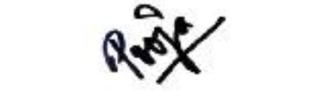
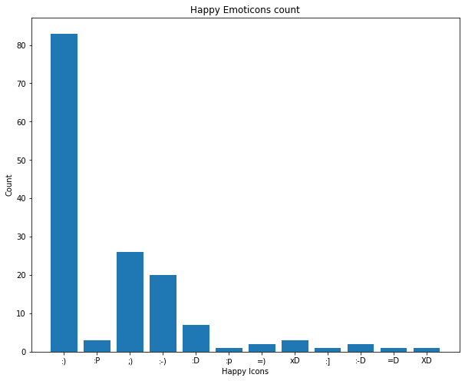
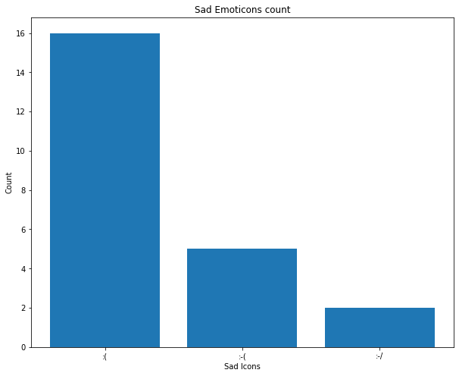
Happy Tweets VS Sad Tweets

Slide 12
Top Trending Words

Slide 13
BIGRAMS FOR NEUTRAL & can’t tell

Slide 14
BIGRAMS FOR Positive & negative

Slide 15
triGRAMS FOR neutral & can’t tell

Slide 16
triGRAMS FOR Positive & negative

Slide 17
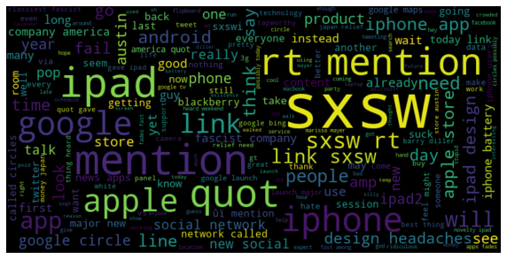
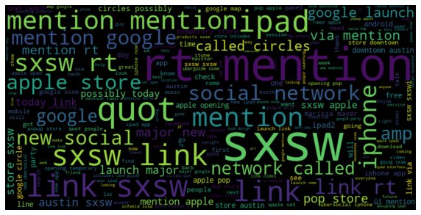
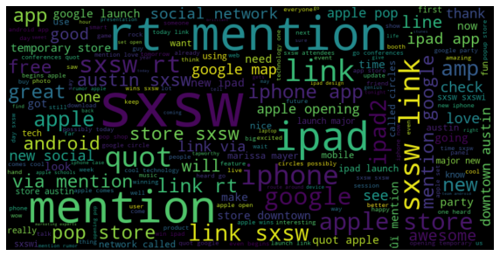
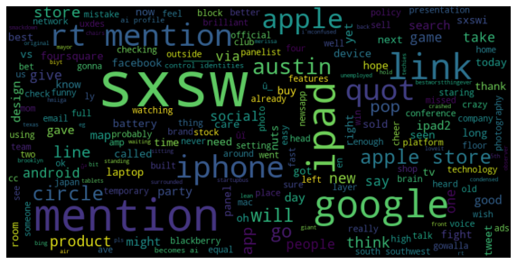
WordCloud
Sentiment 0
Sentiment 1
Sentiment 2
Sentiment 3

Slide 18
Classification Report
Model Name: MultinomialNB
Classification Report:
precision recall f1-score support
0 0.00 0.00 0.00 111
1 0.66 0.96 0.78 1121
2 0.70 0.23 0.35 557
3 0.00 0.00 0.00 30
accuracy 0.67 1819
macro avg 0.34 0.30 0.28 1819
weighted avg 0.62 0.67 0.59 1819
F1-Score: 0.5900326977476591
****************************************
Model Name: RandomForestClassifier
Classification Report:
precision recall f1-score support
0 0.58 0.20 0.30 111
1 0.70 0.90 0.78 1121
2 0.66 0.39 0.49 557
3 0.12 0.03 0.05 30
accuracy 0.68 1819
macro avg 0.51 0.38 0.41 1819
weighted avg 0.67 0.68 0.65 1819
F1-Score: 0.6525395155076741
****************************************

Slide 19
Classification Report
Model Name: SVC
Classification Report:
precision recall f1-score support
0 0.67 0.14 0.24 111
1 0.70 0.93 0.80 1121
2 0.73 0.40 0.52 557
3 0.00 0.00 0.00 30
accuracy 0.71 1819
macro avg 0.52 0.37 0.39 1819
weighted avg 0.70 0.71 0.67 1819
F1-Score: 0.6662120068075892
****************************************
Model Name: LogisticRegression
Classification Report:
precision recall f1-score support
0 0.39 0.39 0.39 105
1 0.75 0.79 0.77 1096
2 0.61 0.59 0.60 582
3 0.00 0.00 0.00 36
accuracy 0.69 1819
macro avg 0.44 0.44 0.44 1819
weighted avg 0.67 0.69 0.68 1819
F1-Score: 0.6788399032791348
****************************************

Slide 20
Conclusion & Insights
In-order to increase the business Witty Wicky Inc. shall implement the following:-
Convert the Negative tweets to positive tweets.
Positive tweets shall be rewarded.
Understand the complex feedback of customers in depth to counter fight the fraud detection.
The organization shall monitor what customers say about their existing product and services, so that they can implement those on the launch of new product for marketing campaign.
With accurate data analysis and deep understanding of polarity of sentiments (as mentioned above), Witty Wicky Inc. can empower business.

Slide 21
Thank you!

